Slide 1
Secure Chatting Program
1900005528-Ahmet Kaan Memioğlu
1900005485-Emrecan Üzüm
1900003587-Şükrü Erim Sinal

Slide 2
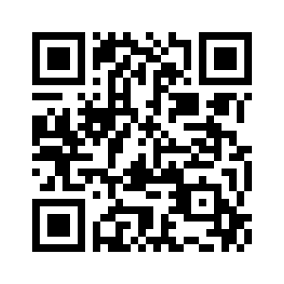
Outline
Our Github Link
1.Tools / Frameworks
2.Development Method
3.Flow of the Program
4.Testing procedures
5.Target Audience

Slide 3
Tools & Frameworks
First of all we have used for Development
M. MongoDB E. Express R. React N. NodeJs
(Mongoose, Socket.io, Scrypt, Axios)
Testing
Google Lighthouse, Cypress, Cypress-Chrome-Reader

Slide 4
Tools & Frameworks
Non Functional
Google Lighthouse
1.Overall Performance 2.Accessibility
3.Best Practices
4.SEO (Search Engine Optimization Advices)
5.PWA (Progressive Web Application)
Functional
-Cypress
1.Record Keystrokes
2.Implement Scenarios
3.Test Features
4.Get Results

Slide 5
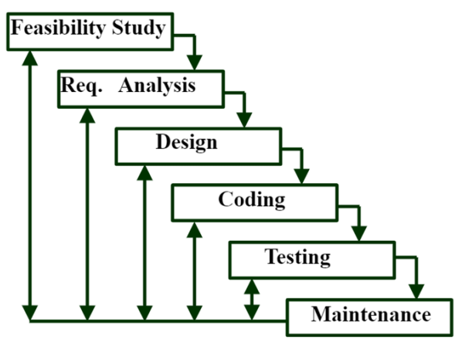
Development Method
Iterative Waterfall
-Creating Accurate applications.
-Providing a less buggy experience.
-Repeating and refining features.
-Beneficial for a small team like us

Slide 6
Development Method
METHODOLOGY
We developed our project using the Waterfall Iterative methodology. The reason we chose this methodology was to finish coding quickly after the analysis and design phase, and to be able to easily return to the coding phase in case of errors when we test.
PLANNING -> ANALYSIS -> DESIGN -> REALIZATION (CODING) -> DEPLOYMENT -> MAINTENANCE
ORGANIZATION
On the project organization side, everyone is aware of the overall functioning of the system and has authority over it. In the analysis and planning part we have identified three main parts: the connection and functioning of the system with the database, the communication and message management between users, and finally the security part based on encryption and decryption.
AXIOS, MONGODB, GENERAL OPERATION -> Ahmet
SOCKET.IO, EXPRESS, GENERAL OPERATION -> Emre
AES ENCRYPTION AND DECRYPTION, GENERAL PROCEDURE -> ŞÜKRÜ

Slide 7
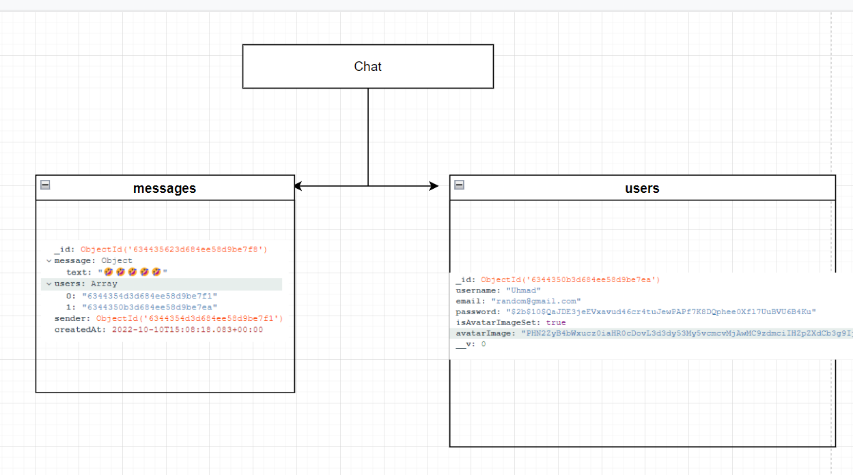
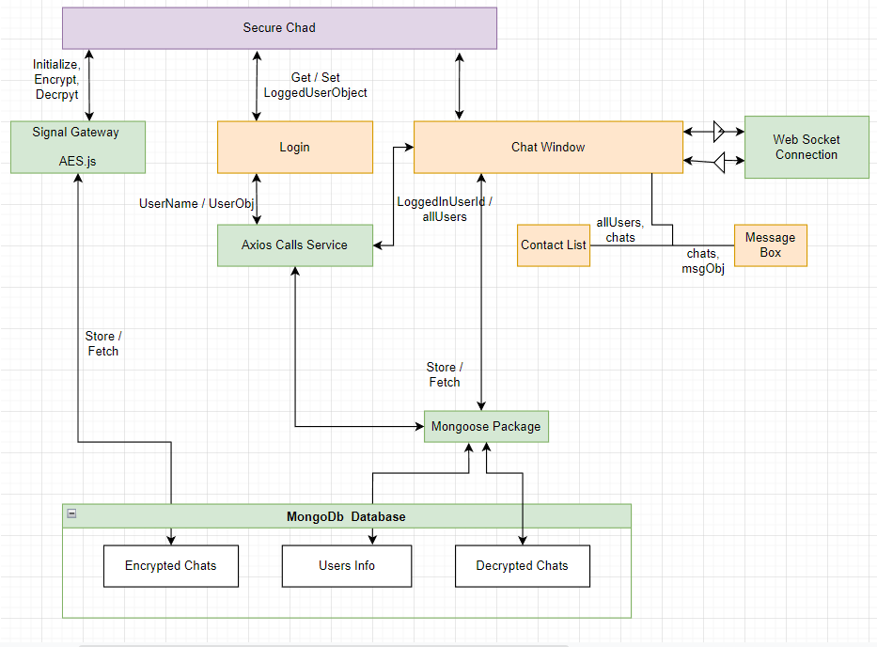
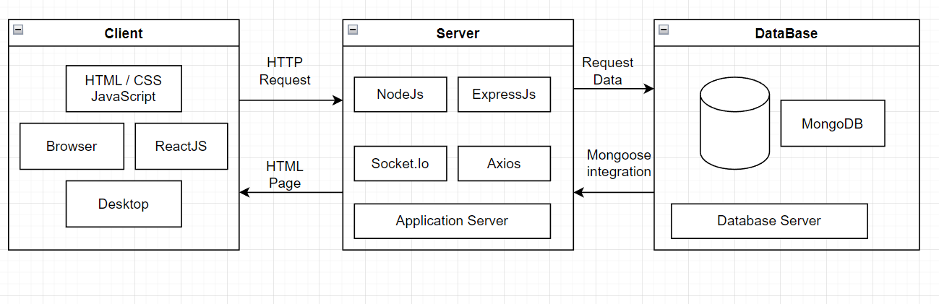
Flow Of the Program

Slide 8
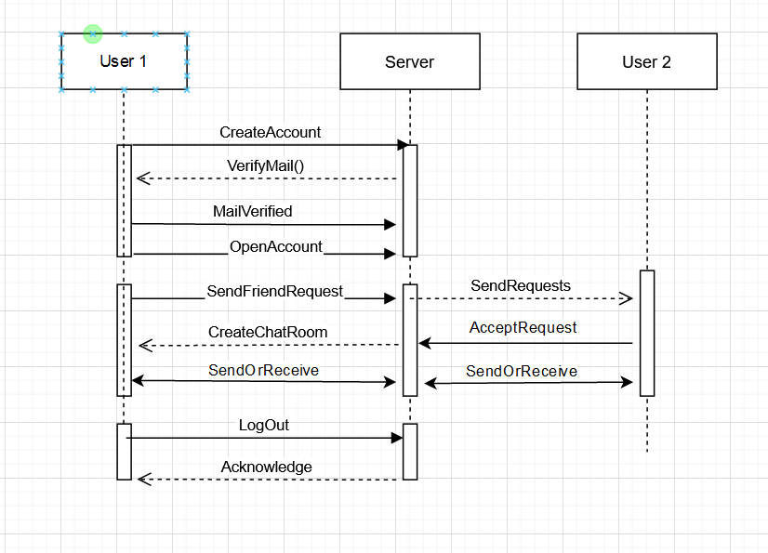
Flow Of the Program
MVP DIAGRAM

Slide 9
Testing Procedures
Non Functional
Functional
Our non-functional testing was done in Google's platform called “Lighthouse” . This platform recorded our MERN stack app’s performance on various categories and gave an overall score as well as the let downs of our code and gave insight about how to fix said issues
Our functional test begins. First of all we used Google Chrome’s Record functionality to record keystrokes and clicks on the webpage so we can export a json file in order to integrate with the Cypress software. We are also using a package called Cypress-Chrome-Recorder on github this essentially gets the export from the chromes json file and converts the file to cypress format to use it in our testing.

Slide 10
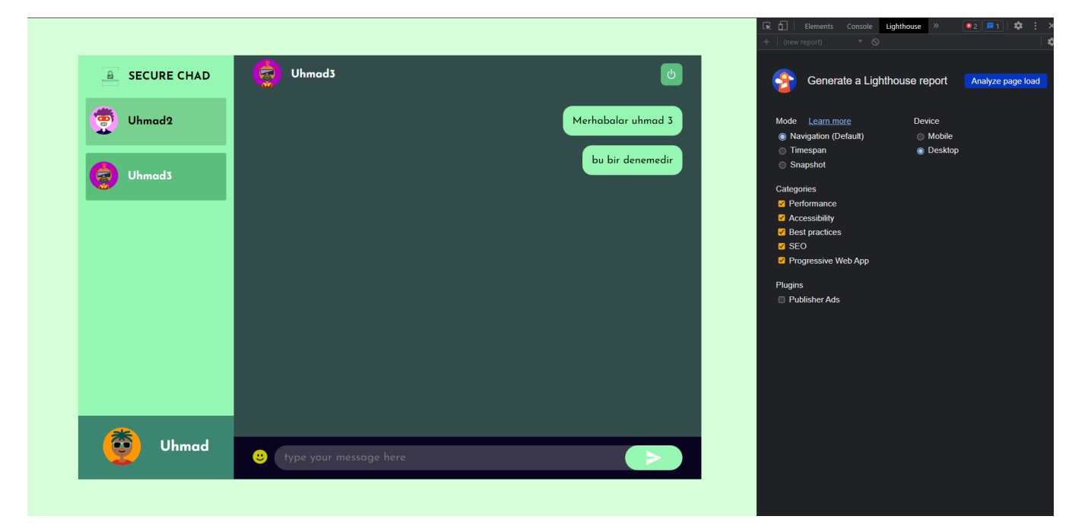
Testing Procedures (Lighthouse [Nonfunctional])

Slide 11
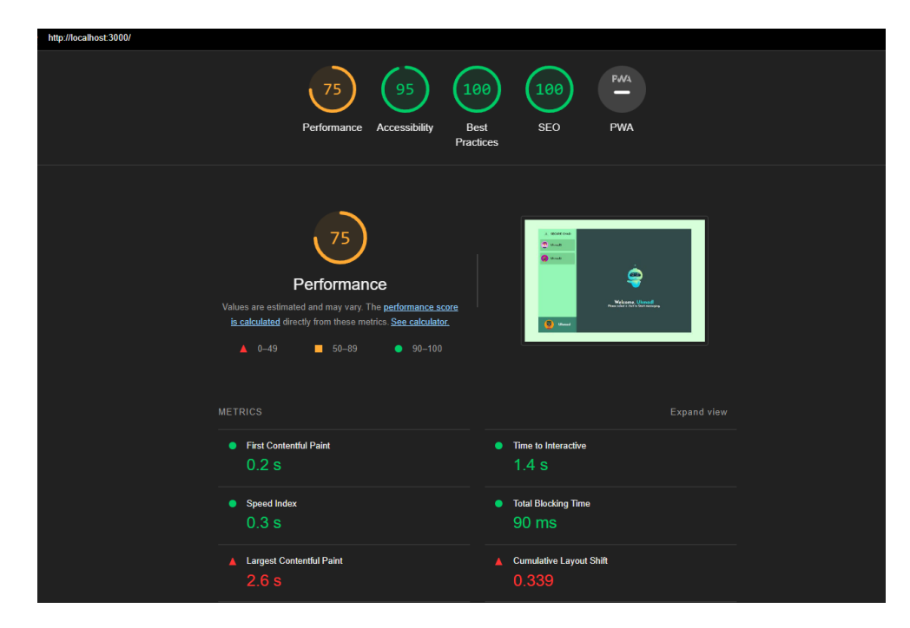
Testing Procedures (Lighthouse [Nonfunctional])

Slide 12
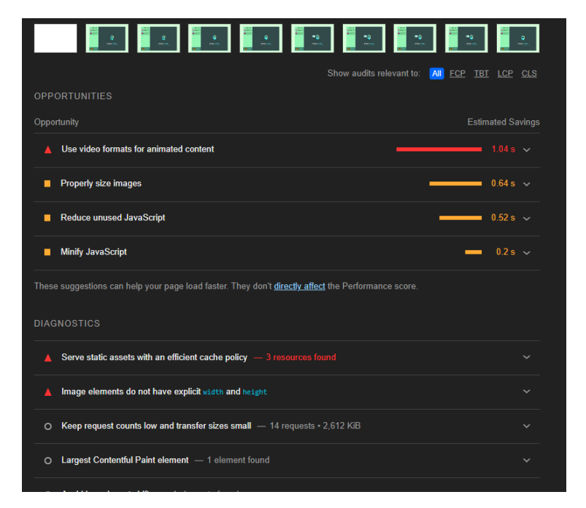
Testing Procedures (Lighthouse [Nonfunctional])

Slide 13
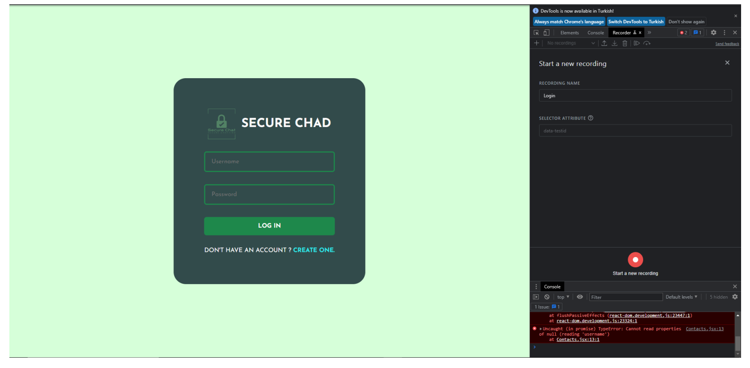
Testing Procedures (Cypress [Functional])

Slide 14
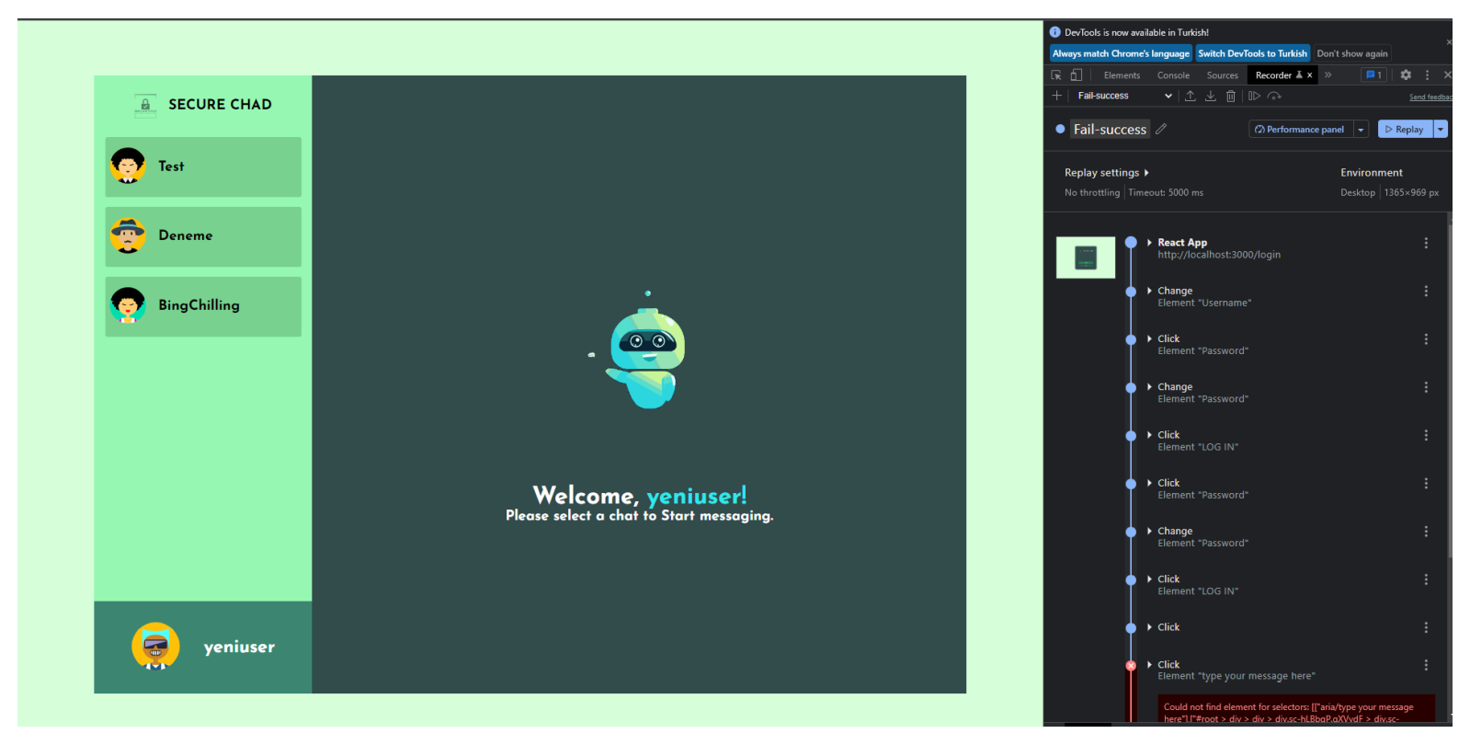
Testing Procedures (Cypress [Functional])

Slide 15
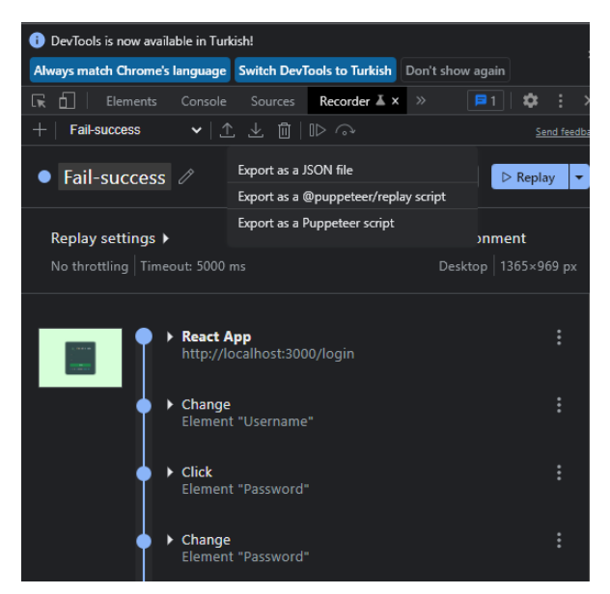
Testing Procedures (Cypress [Functional])

Slide 16
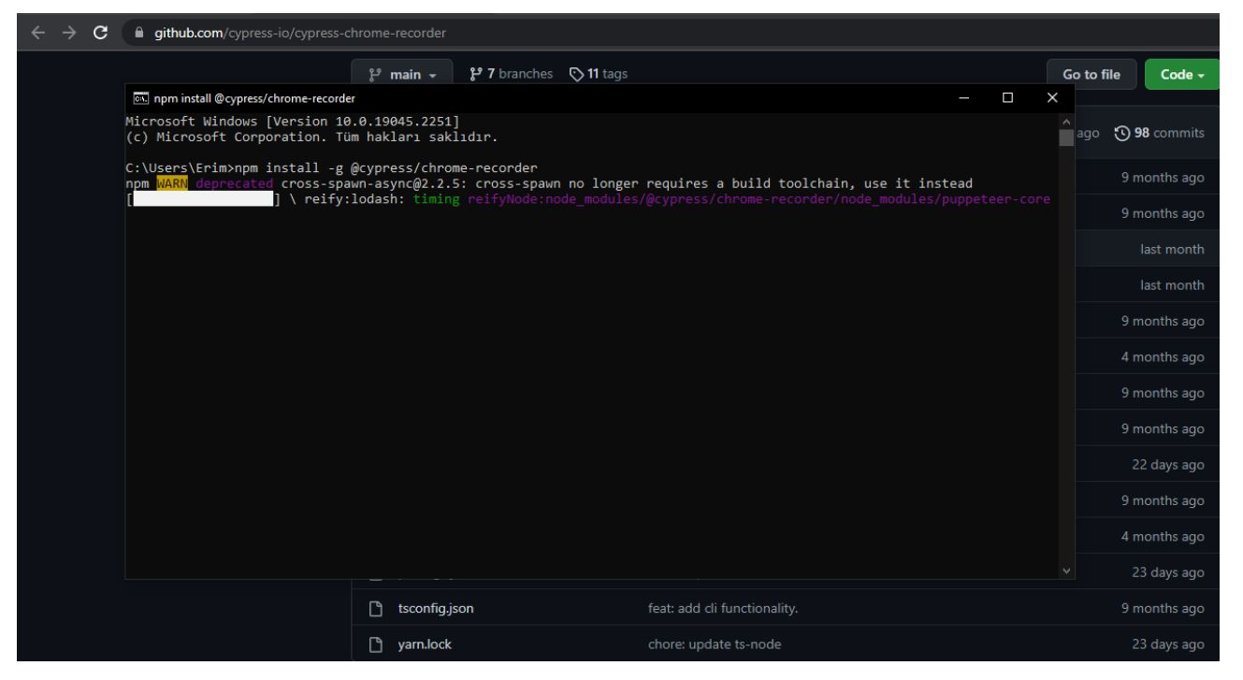
Testing Procedures (Cypress [Functional])

Slide 17
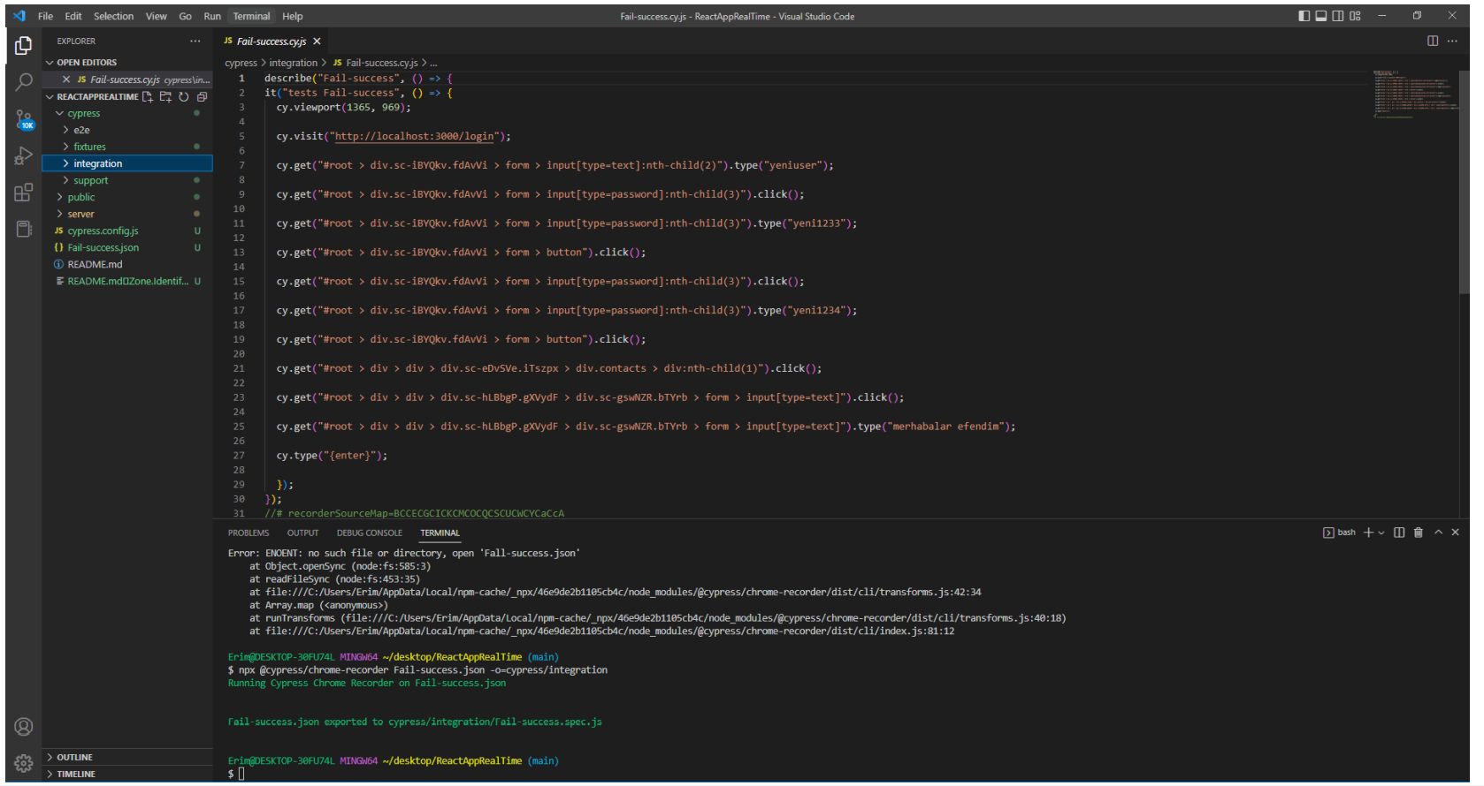
Testing Procedures (Cypress [Functional])

Slide 18
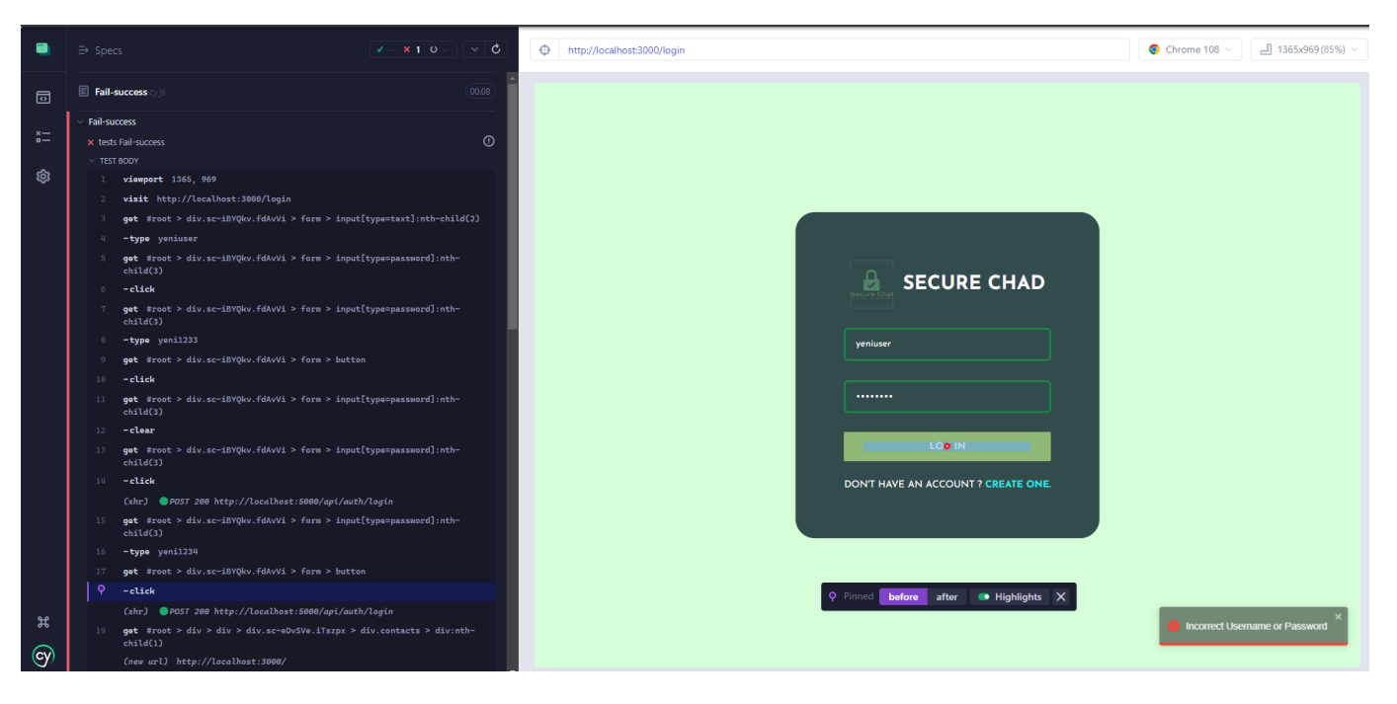
Testing Procedures (Cypress [Functional])

Slide 19
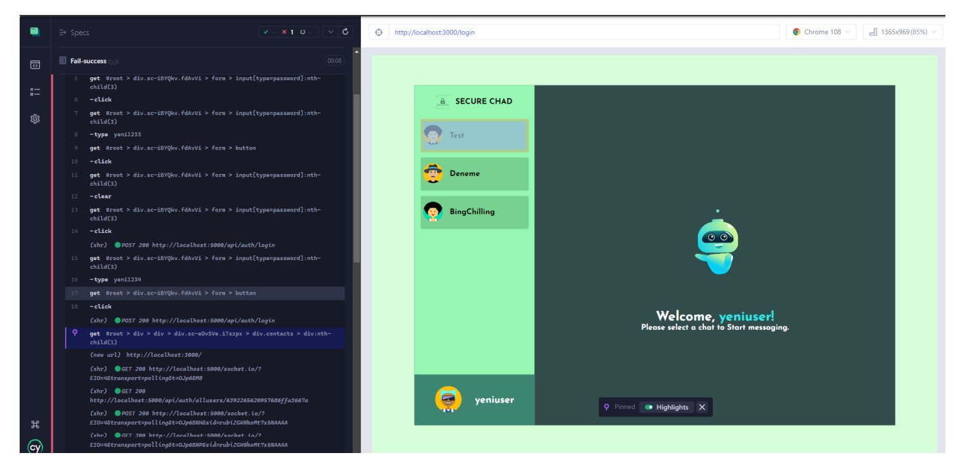
Testing Procedures (Cypress [Functional])

Slide 20
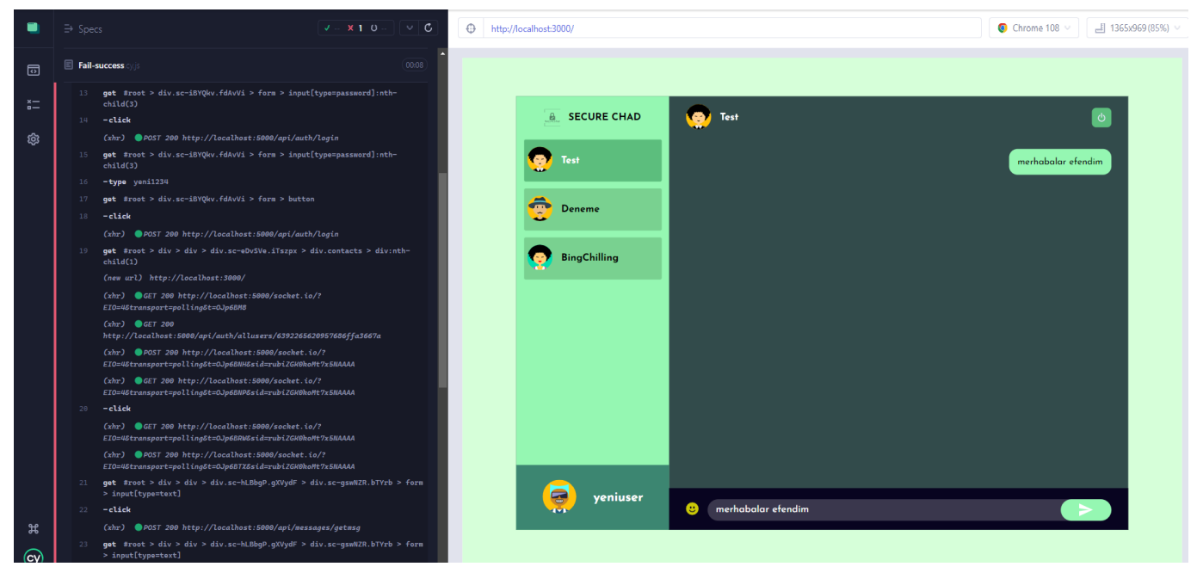
Testing Procedures (Cypress [Functional])

Slide 21
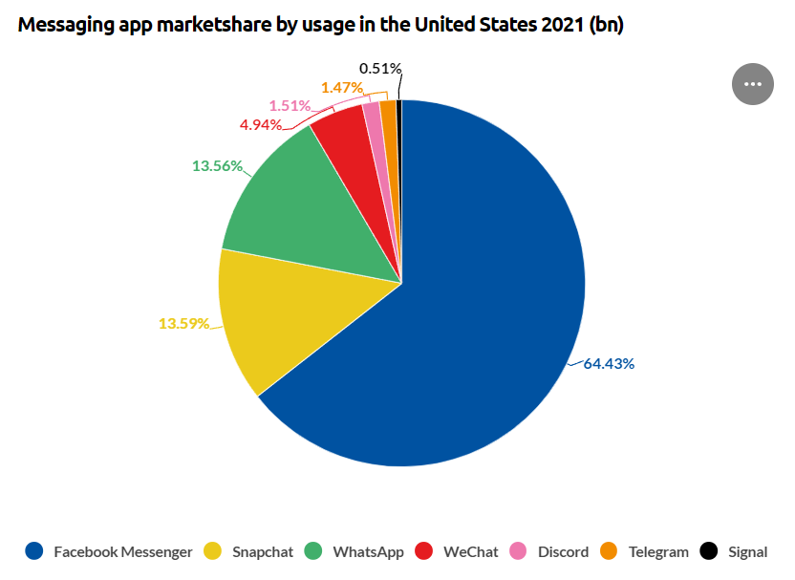
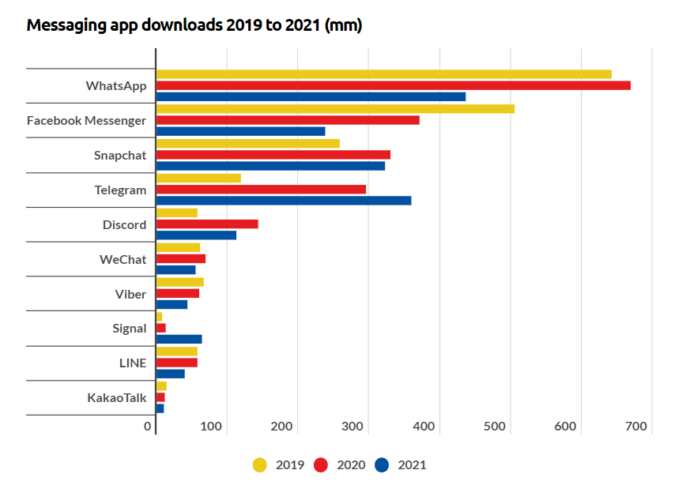
Target Audience
Our app is trying to be a suitable and desirable platform in the Web Based platforms because our competitors are a little bit behind on the web based parts of their applications. It is trying to close the gap of those users needs.
Average cost for mvp for an average app will be figures like “starting from $20K” and “up to $223K for an app like WhatsApp.” Unfortunately, there’s no single accurate number.

Slide 22
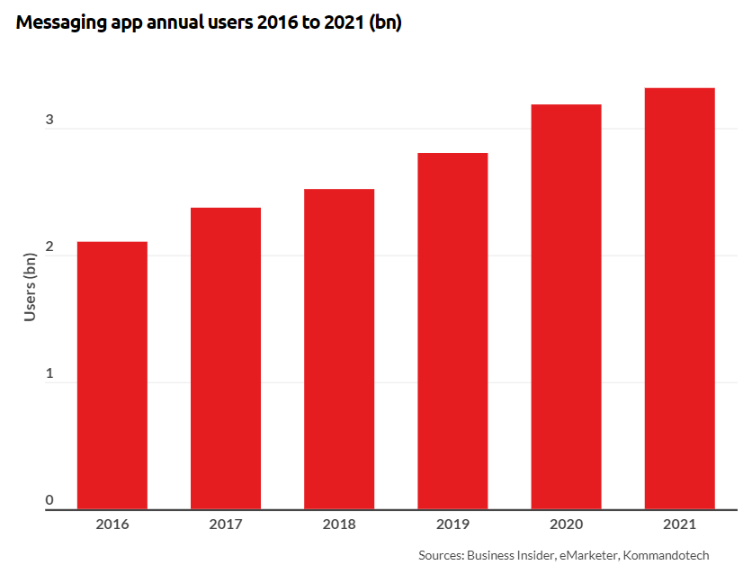
Target Audience
Real-time chat apps have changed the way we communicate and are changing the way we sell and buy things. Companies building a chat app create a million opportunities and benefits for the employees, partners, clients, and prospects they may not know yet. Telegram’s success shows that the messengers market still has room for new players and ideas.
The COVID-19 pandemic had a huge impact on global Chat Application markets at the regional and country level. For the years 2021 and 2022, the study gives three forecast scenarios for the worldwide Chat Application market.
Based on TYPE, the Chat Application market from 2022 to 2029 is primarily split into:
Cloud-Based
On-Premise
Based on applications, the Chat Application market from 2022to 2029 covers:
For Android
For IOS
Others

Slide 23
Thank You For Listening
SECURE CHATTING PLATFORM DONE WITH MERN
1900005528-Ahmet Kaan Memioğlu
1900005485-Emrecan Üzüm
1900003587-Şükrü Erim Sinal

